Slide 1
The Circuit Less Travelled: A Path of Gentrification Through Colorado Neighborhoods
Weston Grewe and Angela Morrison

Slide 2
Motivation
What is gentrification?
“The process whereby the character of a poor urban area is changed by wealthier people moving in, improving housing, and attracting new businesses, typically displacing current inhabitants in the process.”
What impact does it have on our neighborhoods?
Schools
Home prices
Quality of life
What policy changes can we make to reduce these negative effects?
Prohibit large scale development
Reduce/freeze property taxes for long-term residents

Slide 3

Game Plan
Step 1: Clean the data
Step 2: Cluster the data
Step 3: Program the algorithm which performs the circuit walk
Step 4: Interpret the meaning of the steps in the circuit walk
Step 5: Determine policy recommendations based on these interpretations

Slide 4
The Data
5-year period aggregate survey data at the neighborhood level for the state of Colorado (2006-2010,2010-2015,2015-2019)
Columns related to gentrification:
Average income
Highest level of education
Demographic breakdown
Something to keep in mind: these variables all use different scales for their values

Slide 5
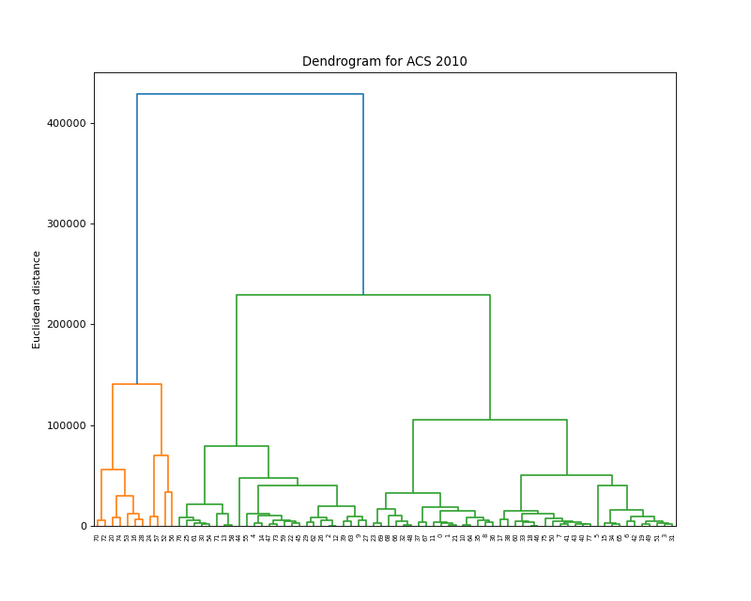
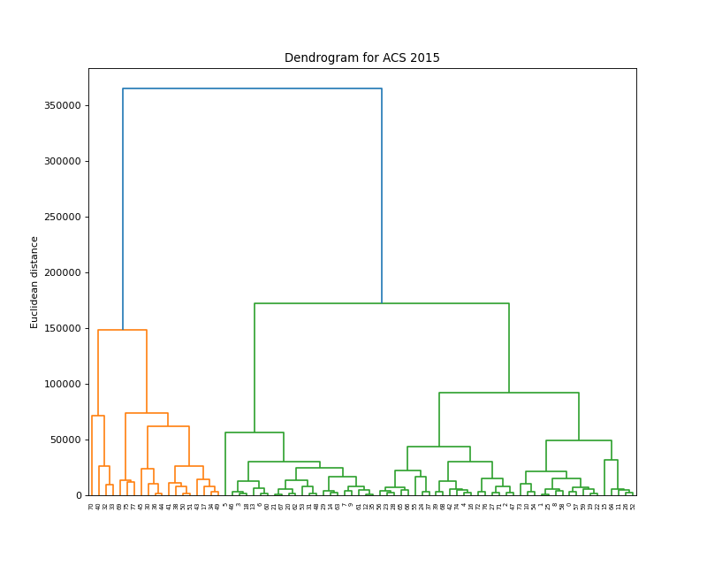
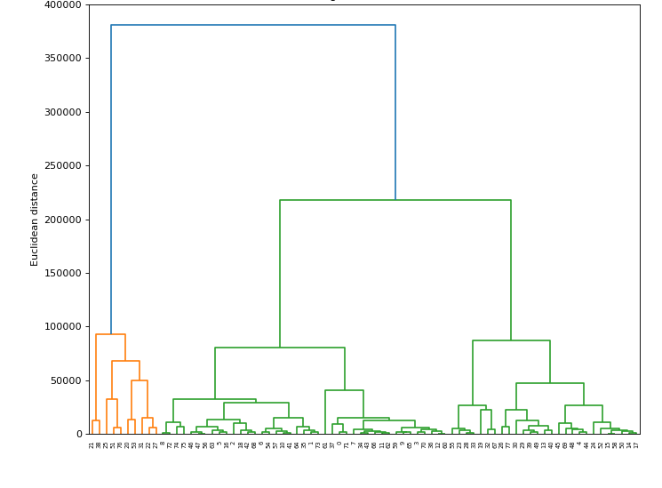
Hierarchical Clustering
2006
2010
2015

Slide 6
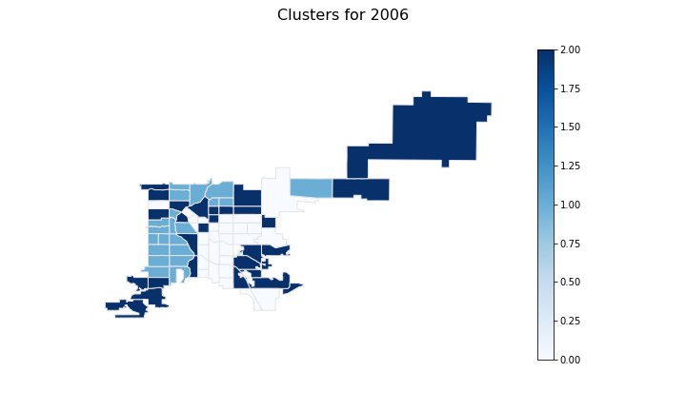
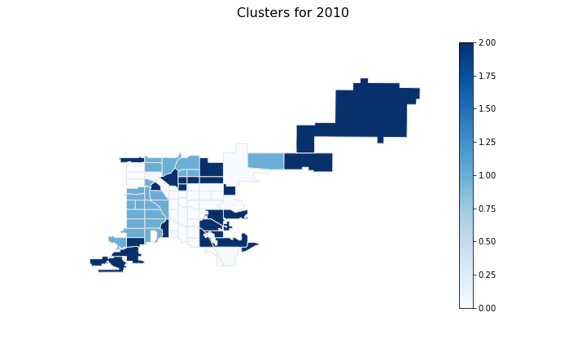

K-Means Clustering
2006
2010
2015

Slide 7
What do the Circuits Mean?
Start
Step 1
Step 2
End
We see where people are going and where they are going.
For us, we are looking at which of the lower income neighborhoods are being overtaken
Example:

Slide 8
Anticipated Results
We want to cluster our data in such a way that the clusters themselves also have meaning.
We use the circuits to express the process of a neighborhood being gentrified by showing the steps of people moving in and out.
By seeing these steps laid out, we can introduce policy to combat the negative effects of gentrification.

Slide 9
References
D. P. 7 policies that could prevent gentrification. Shelterforce. (2021, October 18) Retrieved November 9, 2021, from https://shelterforce.org/2014/05/23/7_policies_that_could_prevent_gentrification/.
Denver Open Data Catalog: American Community survey nbrhd (2006-2010). (n.d.). Retrieved November 9, 2021, from https://www.denvergov.org/opendata/dataset/city-and-county-of-denver-american-community-survey-nbrhd-2006-2010.
Denver Open Data Catalog: American Community survey NBRHD (2010-2014). (n.d.). Retrieved November 9, 2021, from https://www.denvergov.org/opendata/dataset/city-and-county-of-denver-american-community-survey-nbrhd-2010-2014.
Denver Open Data Catalog: American Community survey NBRHD (2015-2019). (n.d.). Retrieved November 9, 2021, from https://www.denvergov.org/opendata/dataset/american-community-survey-nbrhd-2015-2019.
Denver Open Data Catalog: Statistical neighborhoods. (n.d.). Retrieved November 9, 2021, from https://www.denvergov.org/opendata/dataset/city-and-county-of-denver-statistical-neighborhoods.

Slide 10



Questions?

